Slide 1
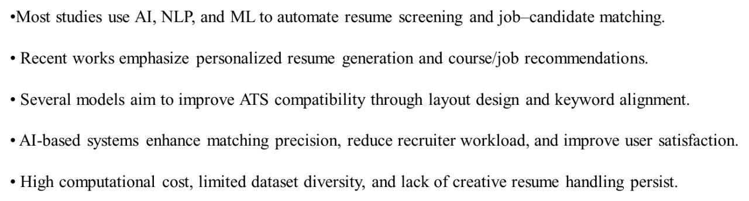
Observations from the Literature Review

Slide 2
Hardware Requirements
Processor: Any modern CPU (e.g., Intel Core i3 or equivalent).
RAM: 4GB or more is recommended for a smooth experience within the browser.
Storage: Minimal, as the application runs from the web and does not require local storage.
Internet Connection: A stable broadband connection is essential for accessing the website and its features.

Slide 3
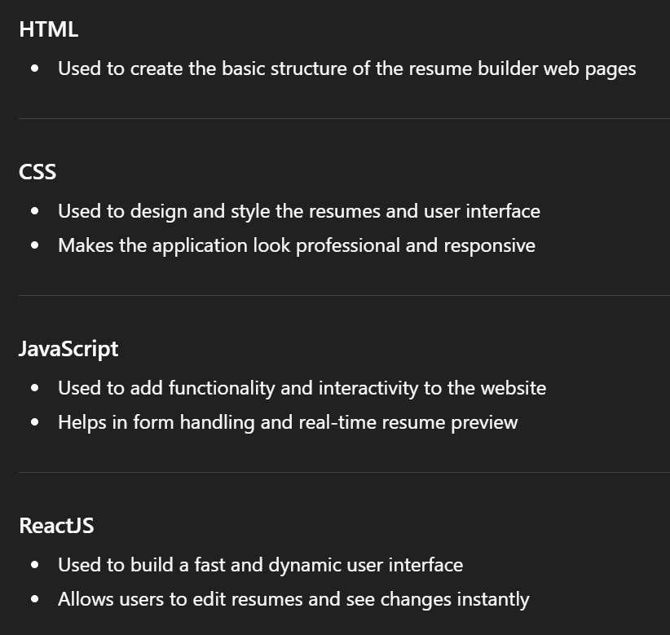

Software Requirements

Slide 4
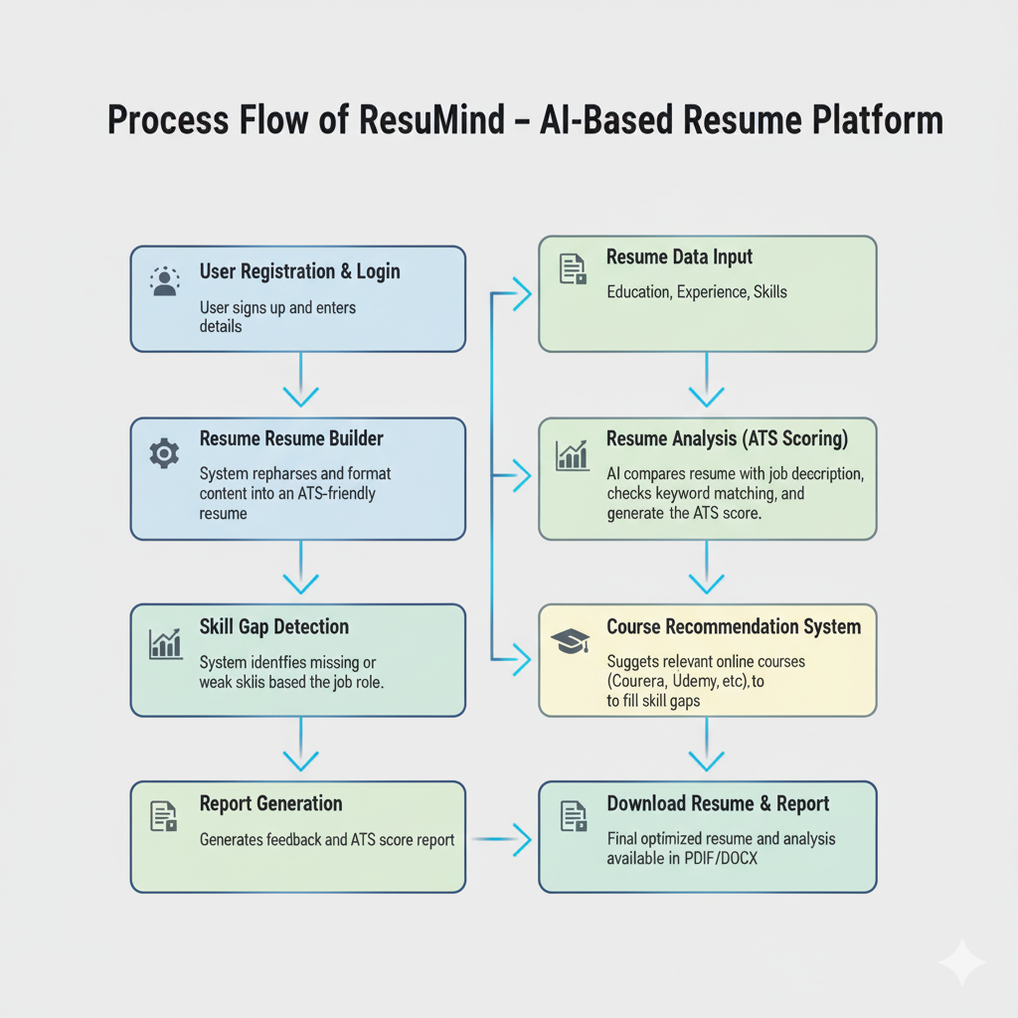
Flowchart of Our Project

